Slide 1

Projects Using React.js & Flux
Project 3: Quick Quiz

Slide 2
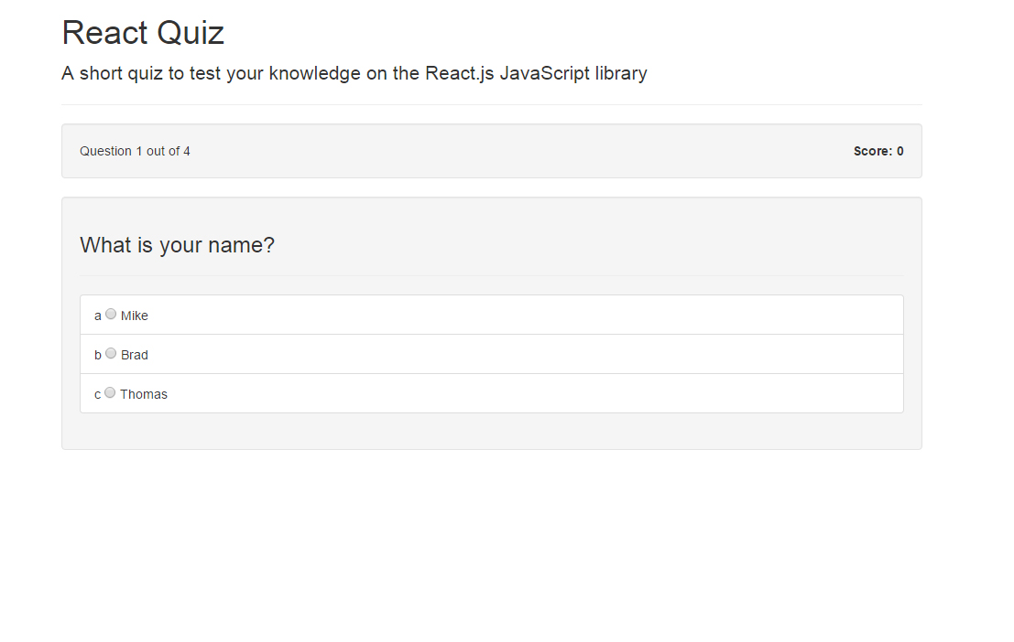
Project Description
An app that will display questions from a JSON state object and let you answer 1 by 1 and show the results at the end

Slide 3
Project Lectures
Section Intro
App Component Setup
QuestionList & Question Components
Quiz Logic

Slide 4
What You Will Learn
How to work with and set states
How to map through state objects
How to use conditionals to output correct props

